Slide 1
Team SocrAItic Circle
AIDebater: Training LLMs to argue and learn
Gaurav Kothamachu Harish
Pengkun Ma
Joel Markapudi
Tanay Grover
Easha Meher Koppisetty

Slide 2
The Idea
Two Large Language Models (LLMs) simulate opposing sides of a debate.
A "judge" (human or AI) evaluates their arguments based on logical consistency, rhetorical strength, and factual accuracy.
Feedback from the judge allows debaters to refine their arguments in an iterative process.
The system integrates human participants into the loop, enabling both humans and AI to improve their debating skills.

Slide 3
Our Goal: what we aim to achieve
Create a dynamic, feedback-driven debate training system.
Combine AI and human input to enhance critical thinking and argumentation.
Provide a platform for iterative skill refinement in debating for both AI agents and human participants.

Slide 4
Importance of our project
Why It’s Interesting:
Explores how AI can simulate diverse perspectives effectively.
Demonstrates the potential for AI-human collaboration in education.
Encourages active learning through iterative improvement.
Why It’s Important:
Fosters critical thinking and logical reasoning skills in human participants.
Advances AI’s ability to understand and refine arguments.
Builds trust in AI systems by integrating humans into the feedback loop.
What Makes It Hard:
Ensuring argument quality (logical, rhetorical, factual).
Designing an effective feedback mechanism.
Balancing AI and human roles for seamless interaction.

Slide 5
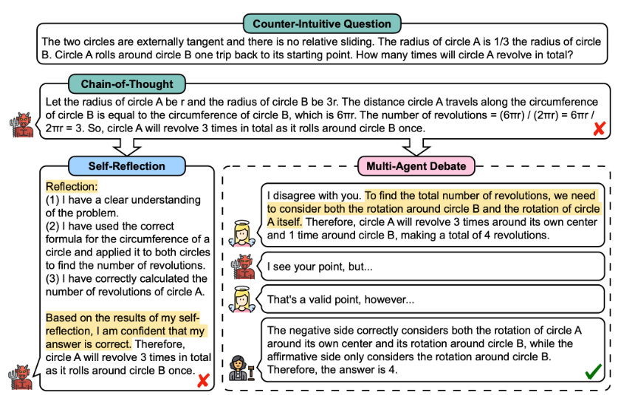
Related Works
Multi-Agent Debate (MAD) for LLMs
Problem: Degeneration of Thoughts (DoT) in Self-Reflection
Self-reflection in LLMs can lead to:
Bias & Distorted Perception – Reinforcing incorrect beliefs.
Rigidity & Resistance to Change – Lack of adaptability.
Limited External Feedback – Missing alternative viewpoints.
Solution: Multi-Agent Debate (MAD)
Two AI models debate to challenge and correct each other.
Reduces bias by exposing flaws in reasoning.
Encourages dynamic learning through mutual feedback.

Slide 6
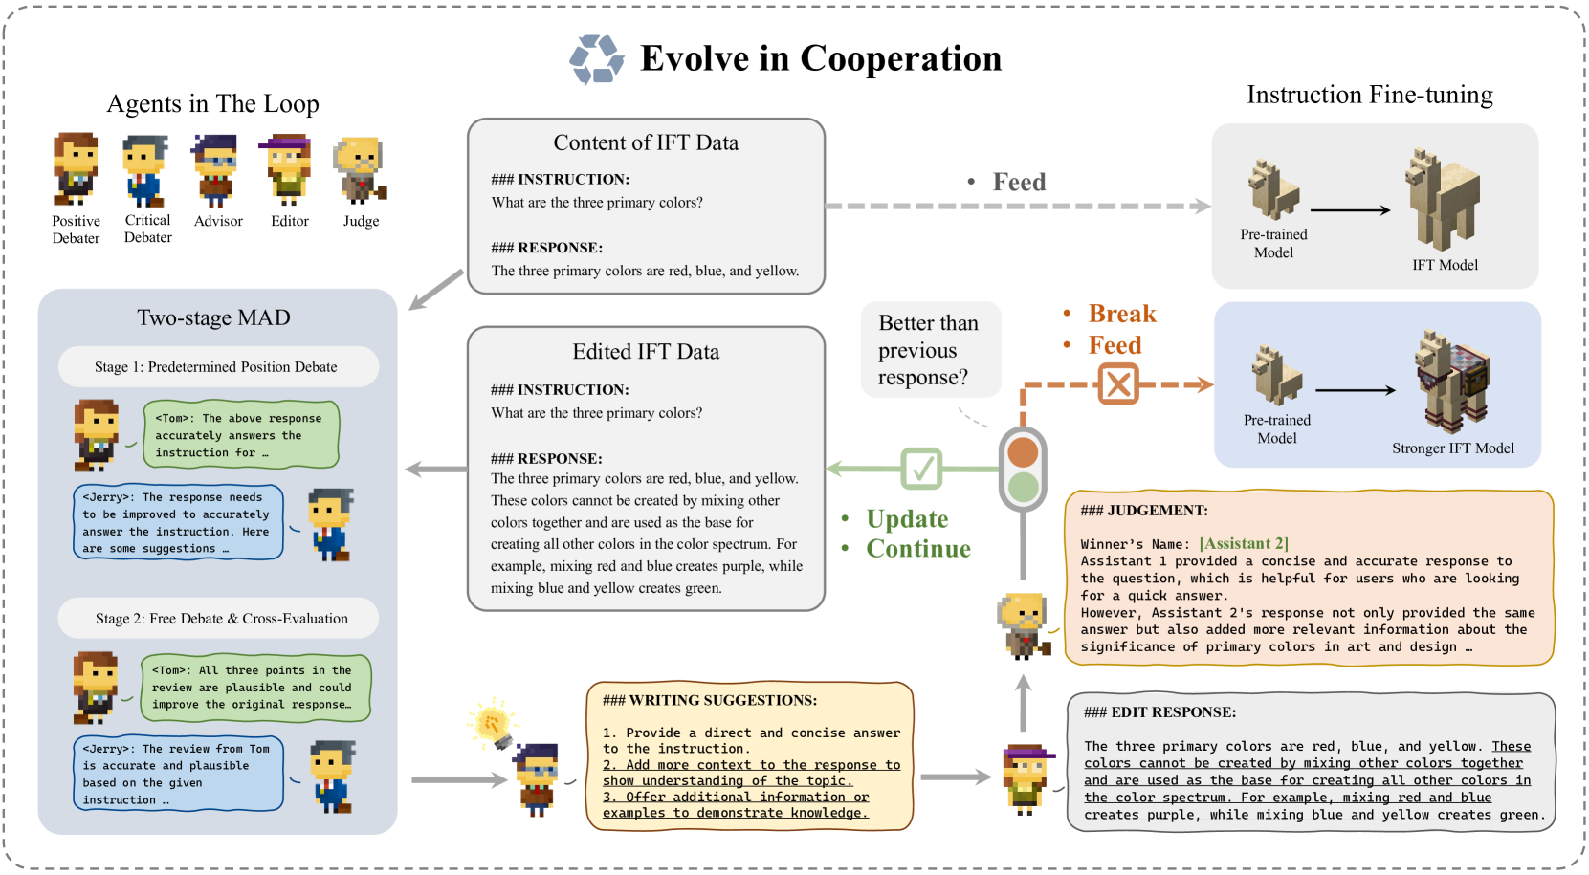
CoEvol Framework
What is CoEvol?
A multi-agent framework to refine LLM-generated responses.
Uses Debate-Advise-Edit-Judge (DAEJ) paradigm for iterative improvement.
How It Works
Debate: Two AI agents argue over the response’s accuracy.
Advise: An advisor suggests refinements based on the debate.
Edit: An AI editor improves the response accordingly.
Judge: A separate AI evaluates if the new response is better.
Why It Matters?
Improves instruction fine-tuning (IFT) data.
Enhances LLM response quality through AI collaboration.
Uses a structured debate approach to refine reasoning.

Slide 7
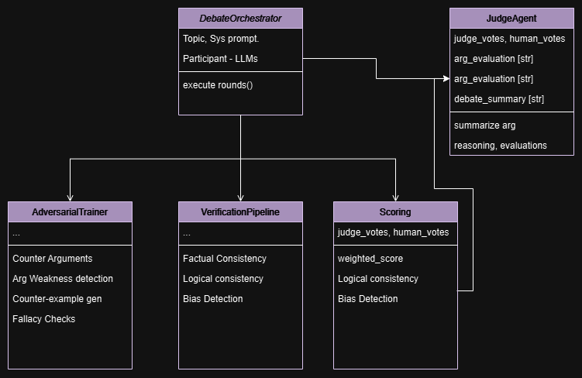
Design - Initial Ideas
Choosing API requests, responses for debate, judging, and scoring.
Hybrid Scoring System.
Adversarial Training.
Multi-LLM agents as Judge.
Debate summarization, Argument analysis.
Logical, Factual Consistency Analysis.
Fallacy analysis.

Slide 8
Primary Hypotheses
H1: Multi-Judge Consensus Hypothesis
"A debate evaluation system using multiple LLM judges with diverse prompting strategies produces more reliable and consistent evaluations compared to single-judge systems"
Rationale: Multiple perspectives and evaluation approaches should reduce bias and increase evaluation reliability
H2: Adversarial Improvement Hypothesis
"Debate agents exposed to adversarial challenges during debates demonstrate improved argument quality and reduced logical fallacies in subsequent debates"
Rationale: The process of defending against and responding to challenges should strengthen argumentation skills

Slide 9
Fine Tuning For Adversarial Training
- Identify logical leaps, Find unstated assumptions, Question causal relationships.
- Request source, Challenge data interpretation, Identify cherry-picked examples.
- Present edge cases, Provide contradicting scenarios, Demonstrate exceptions.
Core things to attack: Logical reasoning patterns, Common fallacies, Argument structures, Academic and debate principles.

Slide 10
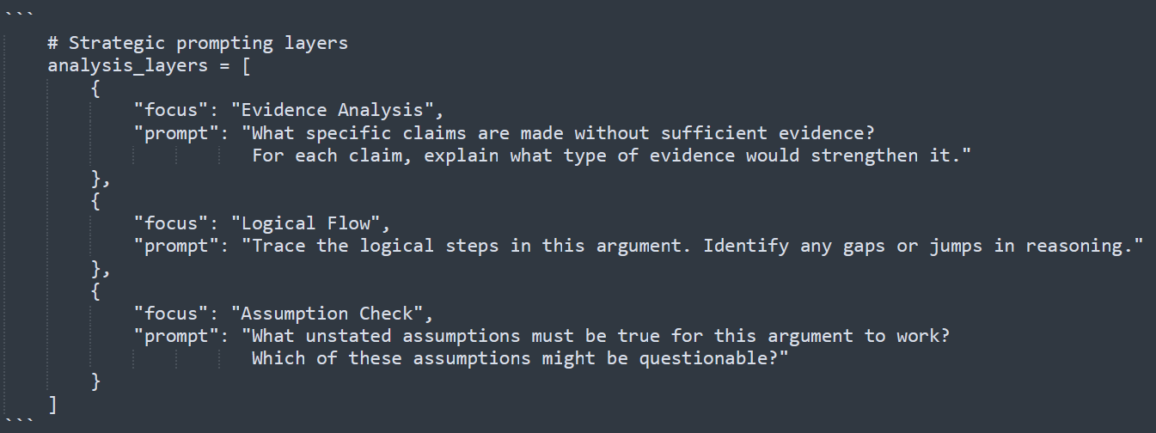
Design - Strategic Prompting Layers
Each layer is a dictionary with a specific focus and prompt template.
Templates are structured to force the LLM to analyze one specific aspect.

Slide 11
Alternative approaches
Approach | Pros | Pros & Cons
Pure LLM-based | Both the agents and Judge will be a custom trained model | Faster execution, consistent behaviour. Limited creativity, potential for bias. Harder to benchmark.
Hybrid Human-AI | Human would provide feedback like how arguments would be judged in professional judge competitions | More nuanced feedback, better quality. Slower, requires human availability.
Permanently train agents | Ensure previous feedback from older debates are used to generate responses | Ensures model’s common weaknesses are addressed, Needs RAG.

Slide 12
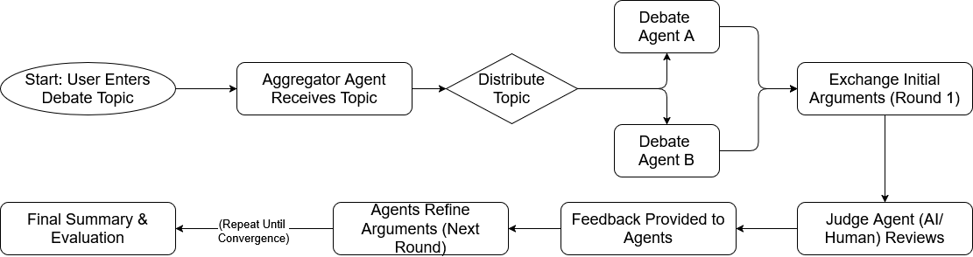
Architecture

Slide 13
Development Stages
Start
Initial Setup and Model Integration
Set up development environment with Python Install core libraries Configure API access for GPT-4 and other LLMs
Feb 17
Multi-Agent Framework Development
Implement two debater agents which interacts with different models, stores context and passes feedback Create judge agent with feedback mechanisms Set up basic logging and monitoring
Mar 10
Feedback Loop Implementation
Design iterative refinement system Implement feedback processing Create evaluation metrics Test system robustness
Mar 24
Testing
Conduct initial testing Refine based on feedback Do performance analysis and provide baseline compared to metrics
Apr 10

Slide 14
Required Libraries/APIs
Challenges
Langchain, LangGraph, Autogen
OpenAI/Mistral/Claude etc. APIs
sentence-transformers, faiss-cpu, huggingface_hub, tiktoken, tenacity
Any UI & visualization packages, orchestration, chat interface utilities.
Maintaining context across multiple debate rounds.
Ensuring logical consistency in arguments.
Implementing effective feedback mechanisms.
Managing computational resources/tokens for models.
Handling edge cases.

Slide 15
(Suggested) Measurable Metrics
‘Quality’ measurement when comparing text outputs from LLMs could be an ambiguous affair. Instead, we depend on a third-party models/frameworks to evaluate and critique the answer.
Weighted judge scores, Categorized scoring (reliability, argument strength, no fallacies, etc.).
Percentage of unanimous decisions.
What seems to be the knowledge deviation among judges.

Slide 16
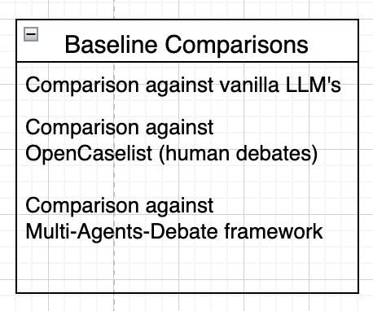
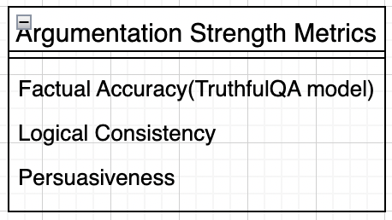
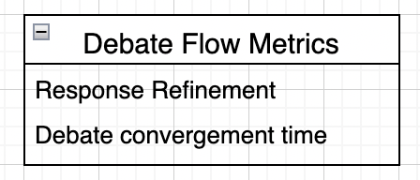
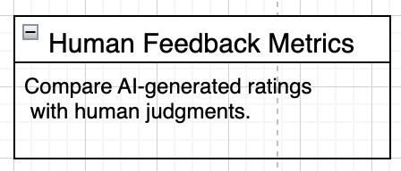
(Suggested) Measurable Metrics continued….

